Slide 1
Fin500J: Mathematical Foundations in Finance
Topic 3: Numerical Methods for Solving Non-linear Equations
Philip H. Dybvig
Reference: Numerical Methods for Engineers, Chapra and Canale, chapter 5, 6 2006 and Dr. Samir Al-Amer’s Lecture Notes
Slides designed by Yajun Wang
Fin500J Topic 3
Fall 2010 Olin Business School

Slide 2
Solution Methods
Several ways to solve nonlinear equations are possible.
Analytical Solutions
  possible for special equations only
Graphical Illustration
  Useful for providing initial guesses for other methods
Numerical Solutions
  Open methods
  Bracketing methods
Fin500J Topic 3
Fall 2010 Olin Business School

Slide 3
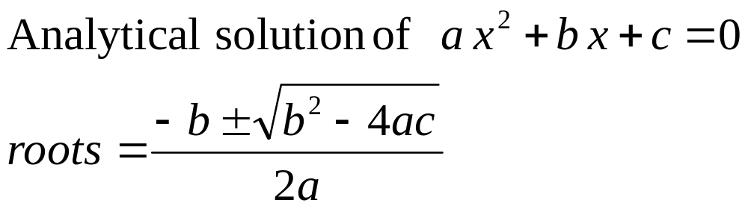
Solution Methods:
Analytical Solutions
Analytical solutions are available for special equations only.
Fin500J Topic 3
Fall 2010 Olin Business School

Slide 4
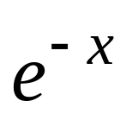
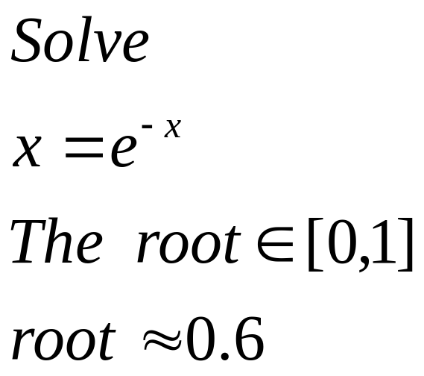

Graphical Illustration
Graphical illustration are useful to provide an initial guess to be used by other methods
Root
2
1
1 2
Fin500J Topic 3
Fall 2010 Olin Business School

Slide 5
Bracketing/Open Methods
In bracketing methods, the method starts with an interval that contains the root and a procedure is used to obtain a smaller interval containing the root.
  Examples of bracketing methods : Bisection method
In the open methods, the method starts with one or more initial guess points. In each iteration a new guess of the root is obtained.
Fin500J Topic 3
Fall 2010 Olin Business School

Slide 6
Solution Methods
Many methods are available to solve nonlinear equations
  Bisection Method
  Newton’s Method
  Secant Method
  False position Method
  Muller’s Method
  Bairstow’s Method
  Fixed point iterations
  ……….
These will be covered.
Fin500J Topic 3
Fall 2010 Olin Business School

Slide 7
Bisection Method
The Bisection method is one of the simplest methods to find a zero of a nonlinear function.
To use the Bisection method, one needs an initial interval that is known to contain a zero of the function.
The method systematically reduces the interval. It does this by dividing the interval into two equal parts, performs a simple test and based on the result of the test half of the interval is thrown away.
The procedure is repeated until the desired interval size is obtained.
Fin500J Topic 3
Fall 2010 Olin Business School

Slide 8
Intermediate Value Theorem
Let f(x) be defined on the interval [a,b],
Intermediate value theorem:
if a function is continuous and f(a) and f(b) have different signs then the function has at least one zero in the interval [a,b]
f(a)
a
b
f(b)
Fin500J Topic 3
Fall 2010 Olin Business School

Slide 9
Bisection Algorithm
Assumptions:
f(x) is continuous on [a,b]
f(a) f(b) < 0
Algorithm:
Loop
1. Compute the mid point c=(a+b)/2
2. Evaluate f(c )
3. If f(a) f(c) < 0 then new interval [a, c]
If f(a) f( c) > 0 then new interval [c, b]
End loop
f(a)
c
b
a
f(b)
Fin500J Topic 3
Fall 2010 Olin Business School

Slide 10
Bisection Method
Assumptions:
Given an interval [a,b]
f(x) is continuous on [a,b]
f(a) and f(b) have opposite signs.
These assumptions ensures the existence of at least one zero in the interval [a,b] and the bisection method can be used to obtain a smaller interval that contains the zero.
Fin500J Topic 3
Fall 2010 Olin Business School

Slide 11
Bisection Method
b0
a0
a1
a₂
Fin500J Topic 3
Fall 2010 Olin Business School

Slide 12
Flow chart of Bisection Method
Start: Given a,b and ε
u = f(a) ; v = f(b)
c = (a+b) /2 ; w = f(c)
no
yes
is
u w <0
no
is
(b-a)/2 <ε
Stop
yes
b=c; v= w
a=c; u= w
Fin500J Topic 3
Fall 2010 Olin Business School

Slide 13
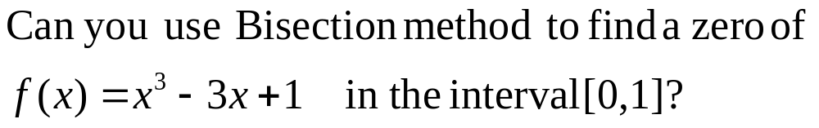
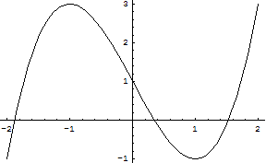
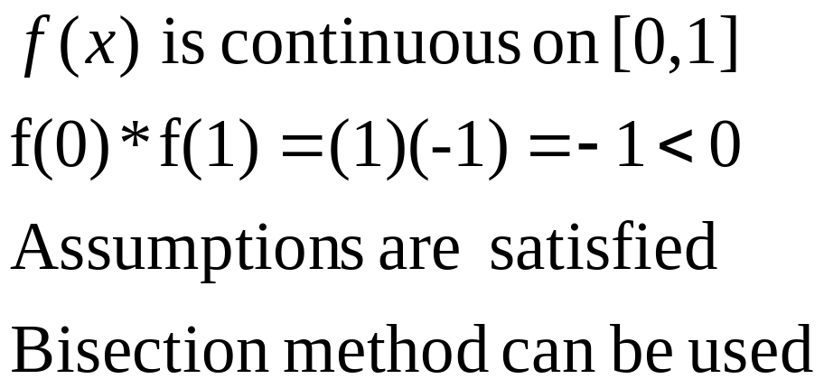
Example:
Answer:
Fin500J Topic 3
Fall 2010 Olin Business School

Slide 14
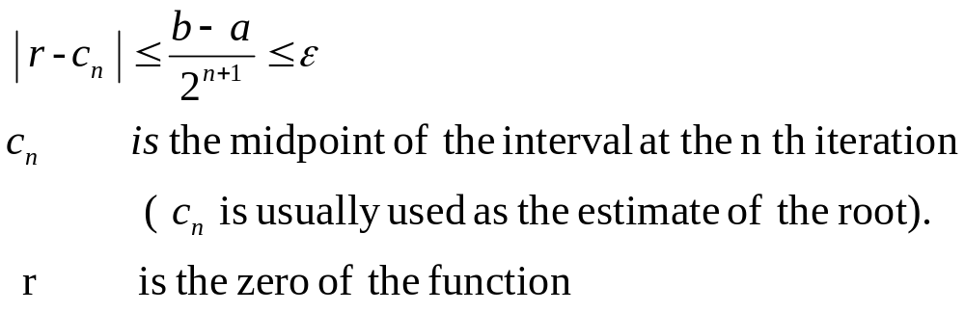
Stopping Criteria
Two common stopping criteria
Stop after a fixed number of iterations
Stop when
Fin500J Topic 3
Fall 2010 Olin Business School

Slide 15
Example
Use Bisection method to find a root of the equation x = cos (x) with (b-a)/2^{n+1}<0.02
(assume the initial interval [0.5,0.9])
Question 1: What is f (x) ?
Question 2: Are the assumptions satisfied ?
Fin500J Topic 3
Fall 2010 Olin Business School

Slide 16
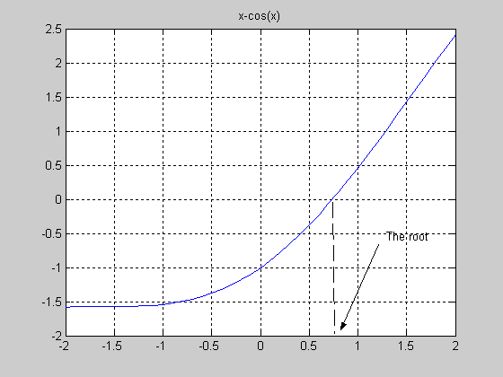
Fin500J Topic 3
Fall 2010 Olin Business School

Slide 17
Bisection Method
Initial Interval
f(a)=-0.3776 f(b) =0.2784
a =0.5 c= 0.7 b= 0.9
Fin500J Topic 3
Fall 2010 Olin Business School

Slide 18
-0.3776 -0.0648 0.2784
(0.9-0.7)/2 = 0.1
0.5 0.7 0.9
-0.0648 0.1033 0.2784
(0.8-0.7)/2 = 0.05
0.7 0.8 0.9
Fin500J Topic 3
Fall 2010 Olin Business School

Slide 19
-0.0648 0.0183 0.1033
(0.75-0.7)/2= 0.025
0.7 0.75 0.8
-0.0648 -0.0235 0.0183
(0.75-0.725)/2= .0125
0.70 0.725 0.75
Fin500J Topic 3
Fall 2010 Olin Business School

Slide 20
Summary
Initial interval containing the root [0.5,0.9]
After 4 iterations
  Interval containing the root [0.725 ,0.75]
  Best estimate of the root is 0.7375
  | Error | < 0.0125
Fin500J Topic 3
Fall 2010 Olin Business School
Notes:
To summarize…

Slide 21
Bisection Method Programming in Matlab
c =
0.7000
fc =
-0.0648
c =
0.8000
fc =
0.1033
c =
0.7500
fc =
0.0183
c =
0.7250
fc =
-0.0235
a=.5; b=.9;
u=a-cos(a);
v= b-cos(b);
for i=1:5
c=(a+b)/2
fc=c-cos(c)
if u*fc<0
b=c ; v=fc;
else
a=c; u=fc;
end
end
Fin500J Topic 3
Fall 2010 Olin Business School

Slide 22
Newton-Raphson Method
(also known as Newton’s Method)
Given an initial guess of the root x₀ , Newton-Raphson method uses information about the function and its derivative at that point to find a better guess of the root.
Assumptions:
  f (x) is continuous and first derivative is known
  An initial guess x₀ such that f ’(x₀) ≠0 is given
Fin500J Topic 3
Fall 2010 Olin Business School

Slide 23
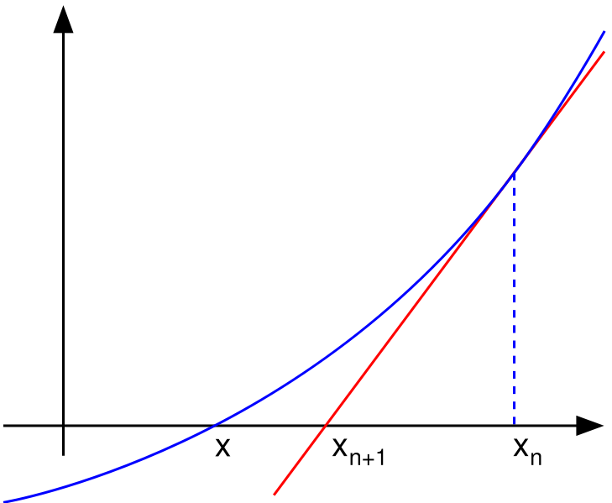
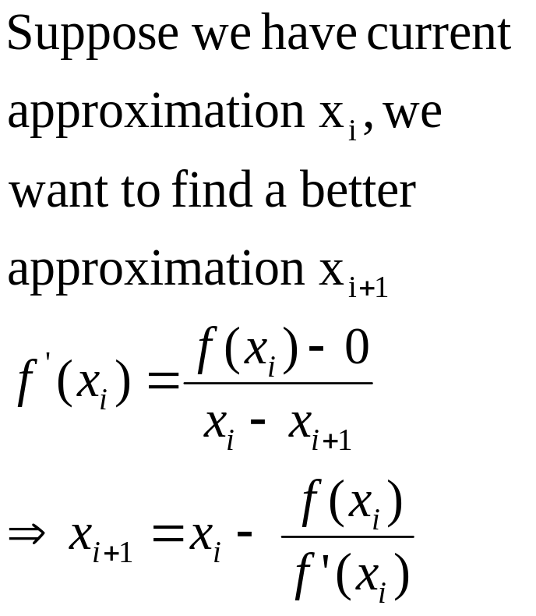
Newton’s Method
X_{i+1} X_{i}
Fin500J Topic 3
Fall 2010 Olin Business School

Slide 24
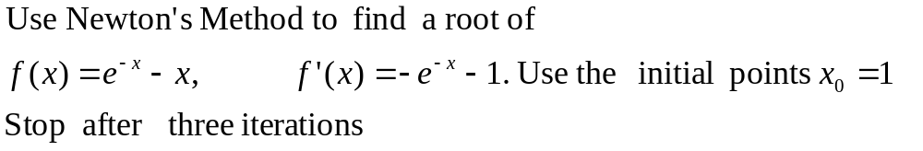
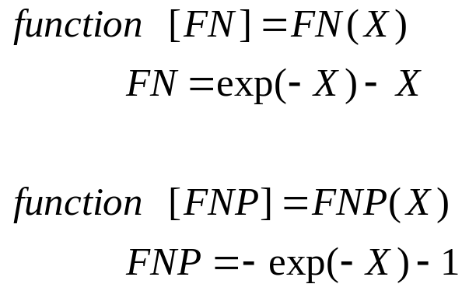
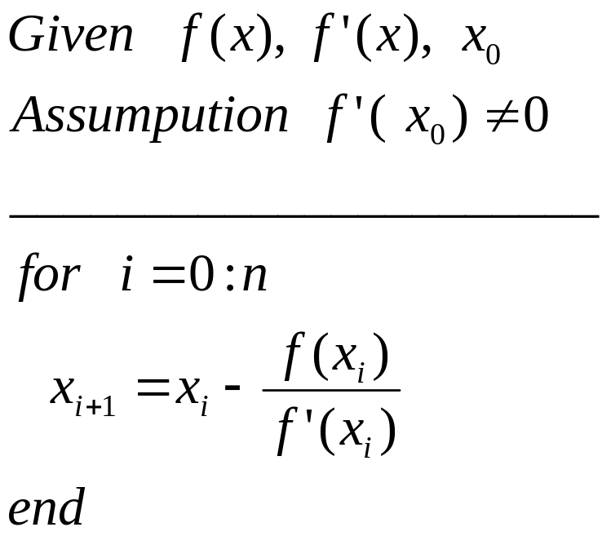
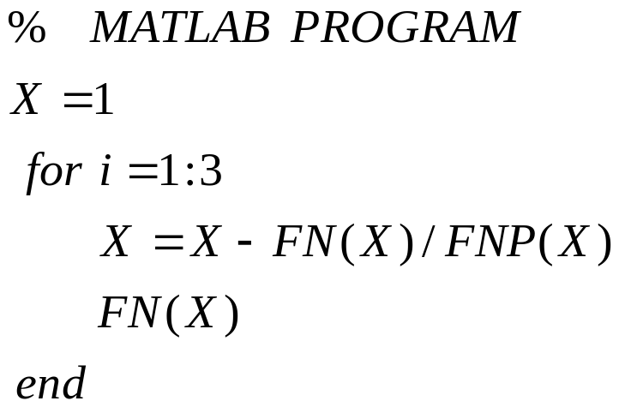
Example
FN.m
FNP.m
Fin500J Topic 3
Fall 2010 Olin Business School

Slide 25
Results
X = 0.5379
FNX =0.0461
X =0.5670
FNX =2.4495e-004
X = 0.5671
FNX =6.9278e-009
Fin500J Topic 3
Fall 2010 Olin Business School

Slide 26
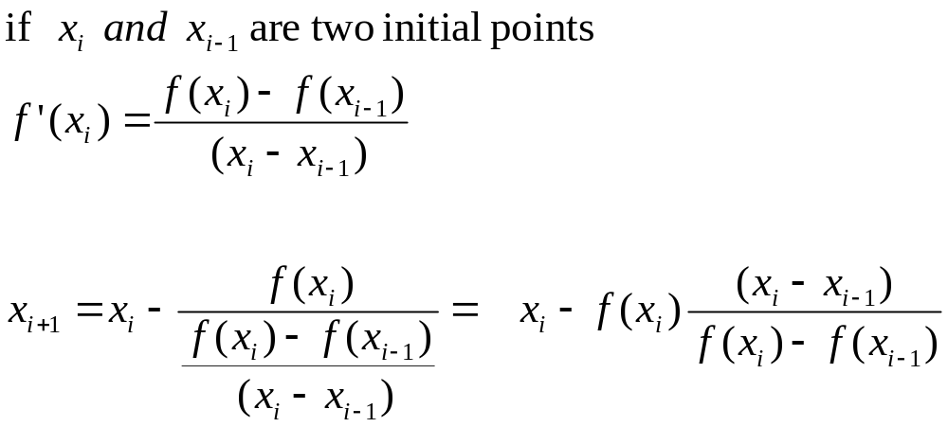
Secant Method
Fin500J Topic 3
Fall 2010 Olin Business School

Slide 27
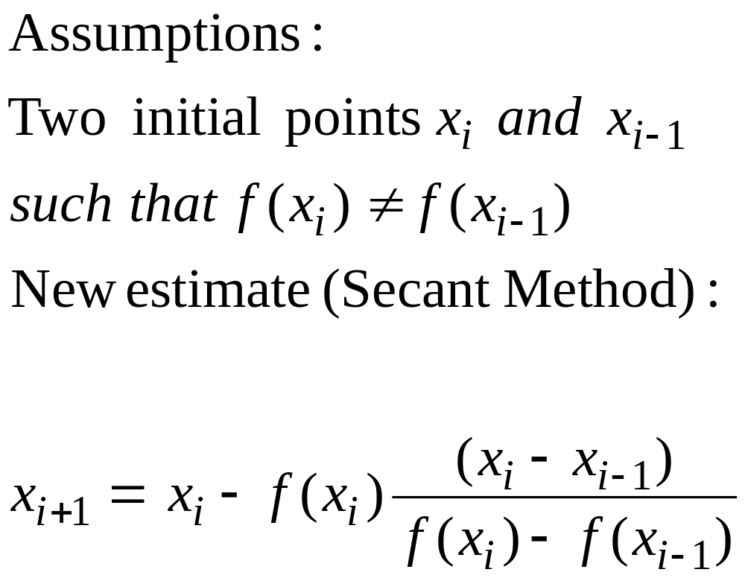
Secant Method
Fin500J Topic 3
Fall 2010 Olin Business School
Notes:
The algorithm is obtained simply by modifying the formula of Newton’s method with two initial points.

Slide 28
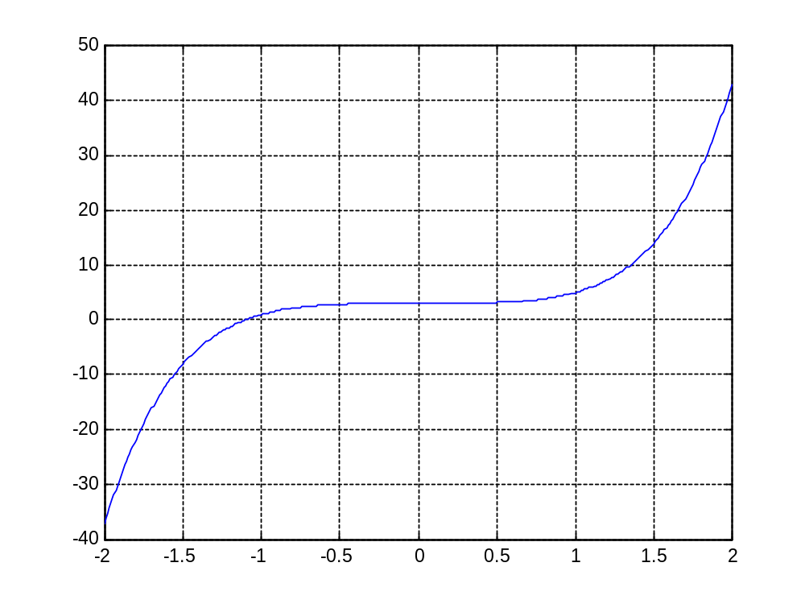
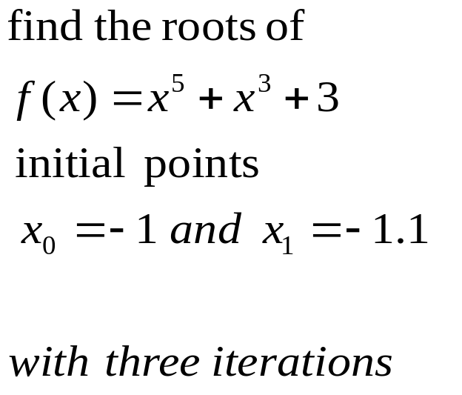
Example
Fin500J Topic 3
Fall 2010 Olin Business School
Notes:
Find the roots of the polynomial with two initial points -1 and -1.1.
Firstly, we plot the graph and see that there is a root around -1.

Slide 29
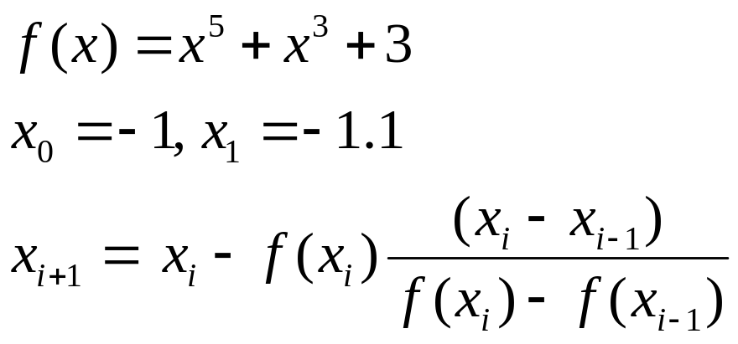
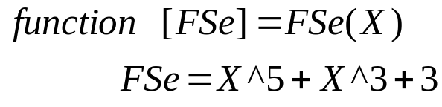
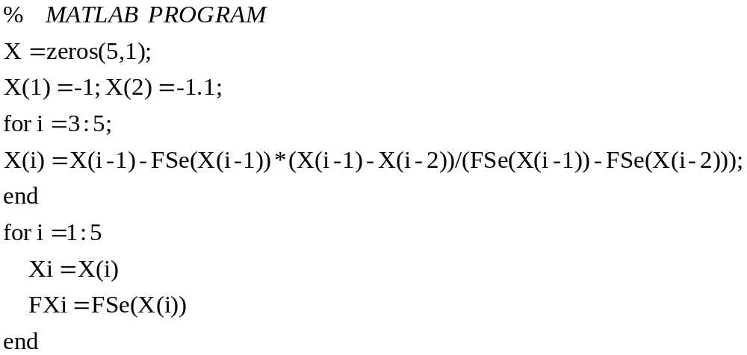
Example
Fin500J Topic 3
Fall 2010 Olin Business School

Slide 30
Results
Xi = -1
FXi =1
Xi =-1.1000
FXi =0.0585
Xi =-1.1062
FXi =-0.0102
Xi =-1.1053
FXi =8.1695e-005
Xi = -1.1053
FXi =1.1276e-007
Fin500J Topic 3
Fall 2010 Olin Business School

Slide 31
Summary
Bisection | Reliable, Slow One function evaluation per iteration Needs an interval [a,b] containing the root, f(a) f(b)<0 No knowledge of derivative is needed
Newton | Fast (if near the root) but may diverge Two function evaluation per iteration Needs derivative and an initial guess x0, f ’ (x0) is nonzero
Secant | Fast (slower than Newton) but may diverge one function evaluation per iteration Needs two initial guess points x0, x1 such that f (x0)- f (x1) is nonzero. No knowledge of derivative is needed
Fin500J Topic 3
Fall 2010 Olin Business School
Notes:
Example of diverge

Slide 32
Solving Non-linear Equation using Matlab
Example (i): find a root of f(x)=x-cos x, in [0,1]
>> f=@(x) x-cos(x);
>> fzero(f,[0,1])
ans =
0.7391
Example (ii): find a root of f(x)=e^{-x}-x using the initial point x=1
>> f=@(x) exp(-x)-x;
>> fzero(f,1)
ans =
0.5671
Fin500J Topic 3
Fall 2010 Olin Business School

Slide 33
Solving Non-linear Equation using Matlab
Example (iii): find a root of f(x)=x⁵+x³+3 around -1
>> f=@(x) x^5+x^3+3;
>> fzero(f,-1)
ans =
-1.1053
Because this function is a polynomial, we can find other roots
>> roots([1 0 1 0 0 3])
ans =
0.8719 + 0.8063i
0.8719 - 0.8063i
-0.3192 + 1.3501i
-0.3192 - 1.3501i
-1.1053
Fin500J Topic 3
Fall 2010 Olin Business School

Slide 34
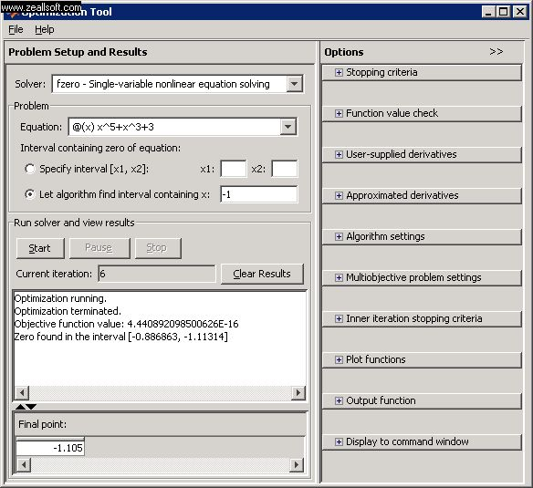
Use fzero Solver in Matlab
>>optimtool
For example:
want to find a root around -1 for x⁵+x³+3=0
The algorithm of fzero uses a combination of bisection, secant, etc.
Fin500J Topic 3
Fall 2010 Olin Business School

